Slide 1


TACH Trans-America Consortium of the HCSRN for the All of Us PMI Cohort Program Co-PIs: Christine C. Johnson, PhD Brian K. Ahmedani, PhD NIH Award #: OT2OD024610

Slide 2
Henry Ford Health System (Lead Site)
Cathy Peltz
Renee Williams
Karen Kippen
Ilan Rubinfeld
Geoff Patterson
Pravin Sapre
Yong Hu
Al Levin
Christine Joseph
Lois Lamerato
Dan McLaren
Kim Sadlocha

Slide 3
Partner Health Systems
YEAR 1 Recruitment Sites
Spectrum Health (PI: Sandra Cottingham; Dave Chesla)
Baylor Scott & White Health (PI: Giovanni Filardo; John Zeber)
Proposed Future Expansion Sites
Essentia Health (PI: Steve Waring)
Meyers Primary Care Institute (PI: Kathy Mazor)

Slide 4
Other Consortia
University of Pittsburgh
University of Arizona / Banner Health
New York Consortium
Illinois Consortium
New England Consortium
Geisinger Health
University of California Consortium
FQHCs throughout the country
Veterans Health Administration

Slide 5
Proposed TACH Recruitment and Affiliate Sites and States with Funded HPO PMI Sites
Essentia Health
Idaho, Minnesota, North Dakota, Wisconsin
*Henry Ford
Health System & Spectrum Health
Michigan
Meyers Primary Care Institute
Massachusetts
States with Funded HPO PMI Recruitment Sites for Year 1
States with Proposed TACH Sites; *indicates recruitment planned for Year 1
*Baylor Scott & White Health
Texas
Notes:
ALTERNATIVE SLIDE #1
EDITING INSTRUCTIONS
Click on a text box to edit (outline is dashed), nudge or delete (outline is solid line).
Click on a call out line and CTRL+arrow keys to nudge. Click end points to lengthen/shorten the line.
To remove a state use the Format Painter tool or click the state and Format / Shape Fill as R185, G205, B229 (light blue).
To add a state use the Format Painter tool or click the state and Format / Shape Fill as R0, G84, B166 (dark blue).
Simply copy/paste and then reposition labels and call out lines for new states or sites added.
Ungroup KPHI and MHS to remove just one of these sites from the map.

Slide 6
Overview
PMI-CP Vision
Key Attributes of TACH
Integrated Delivery Networks
Embedded Researchers
PCOR Culture
HCSRN 20+ Years
Growth Potential
Notes:
CCJ
Good Afternoon, on behalf of our team and joining us via the webinar we would like to

Slide 7
All of Us: One in a Million
Enrollment of 8,000 volunteers in Year 1 across TACH (HFHS, BSW, SH)
To begin recruitment at HFHS in May/June 2017.
Total enrollment of 150,000 volunteers in Years 1-5 across TACH
Total program enrollment of >1 million patients with EHR, survey, physical evaluation, and biospecimen collected
Program enrollment with survey and EHR data can be substantially larger (millions of individuals).
10 year planned program.
Expectation is for this program to be a lifetime cohort and provide infrastructure for ‘thousands’ of ancillary studies.

Slide 8

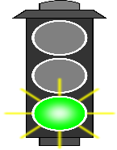

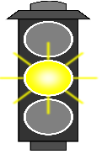



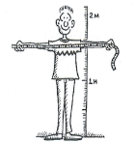
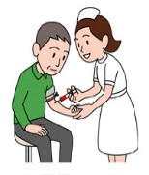


Enrollment Process Options: Primarily Digital
Option 1 | Digital Use | Clinic Time | Time to Full Enrollment | Participant Burden | Control over Data completeness
High
Medium
Low
eConsent
PPI sociodem
PPI 2 enrollment
mods
Clinic
Schedule
Clinic Visit
Ongoing Engagement & Retention
More PPI Mods
EHR
Complete
4 PPI mods
V2,3… Protocols or
Ancillary studies
“Site pairing”
Access to Info
Fully enrolled!
TIME
Within 1 year from enrollment?
1 year and beyond

Slide 9
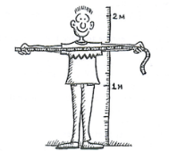

Enrollment Process Options: 2 Clinic Visits
Option 2 | Digital Use | Clinic Time | Time to Full Enrollment | Participant Burden | Control over Data completeness
High
Medium
Low
Clinic
eConsent
PPI
2 enrollment
mods
Clinic
PPI
sociodem
Ongoing Engagement & Retention
More PPI Mods
Schedule
Clinic Visit
V2,3… Protocols or
Ancillary studies
Complete
4 PPI retention
mods
EHR
Access to Info
Fully enrolled!
TIME
Within 1 year from enrollment?
1 year and beyond

Slide 10
Enrollment Process Options: Clinic visit
Option 3 | Digital Use | Clinic Time | Time to Full Enrollment | Participant Burden | Control over Data completeness
High
Medium
Low
Clinic
EHR
Note: Yellow because strategy does not necessarily target enrollments to participants who are underrepresented in biomedical research
eConsent
PPI
sociodem
Ongoing Engagement & Retention
More PPI Mods
PPI
2 enrollment
mods
Complete
4 PPI retention
mods
V2,3… Protocols or
Ancillary studies
Access to Info
Fully enrolled!
TIME
Within 1 year from enrollment?
1 year and beyond

Slide 11
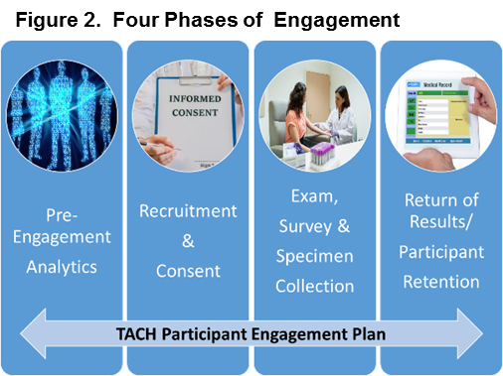
Notes:
Approach Same across all sites
Integrating recruitment into normal care processes
Involve providers into our recruitment approach because that is what we heard from our patients.
Phase I- Pre-Engagement. Because we are an IDN, we can identify where and when our patients are going to interact with us and use that information to meet them where they live and work.
Phase II- AS part of their usual care we will integrate recruitment and consent with our boots on the ground recruiters that are imbedded in our health care delivery sites.
Phase III- Once again, we can integrate the survey and specimen collection to make it convenient for our patient partners
Phase IV- Although we have a myriad of ways that we currently engage our patients, on of the most efficient is the My Chart patient portal, all the HCSRN sites have them, and we will leverage this to continually listen and provide information to our patient partners.
Although we envision a perfect world, our long experience has taught us many lessons including how be agile and adapt our approaches and processes to reach our goals

Slide 12
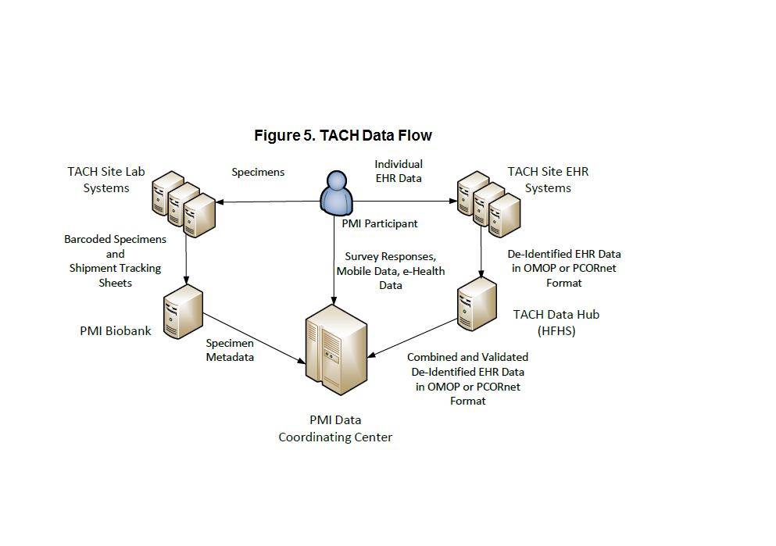

Slide 13
Thank You Questions?

